Slide 1
Beginning Farmer Webinar
In order to participate in today’s webinar, please connect to audio using your computer or phone. You will not be able to hear the presenters without completing this step.

Slide 2
This webinar is being offered as part of a Southern Extension Risk Management Education grant, titled “Reducing Human and Financial Risk for Beginning, Military Veteran, and Historically Underserved Farmers through Farm Stress, Wellness, and Safety Education”

Slide 3
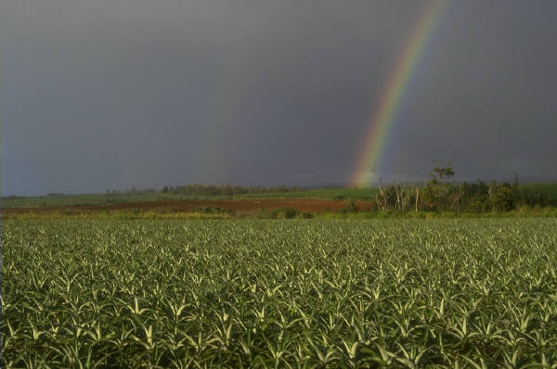
STRESS ON THE FARM: GETTING THROUGH AND THRIVING
DEBORAH B. REED. Phd,faaohn,faan,rn
University of Kentucky

Slide 4
What’s So Good About a Farm?
Shared and individual responsibility
Shared and individual income
Clean(er) air
Community atmosphere

Slide 5
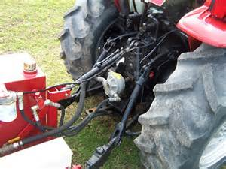
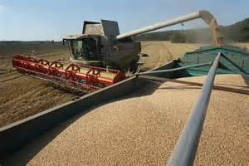
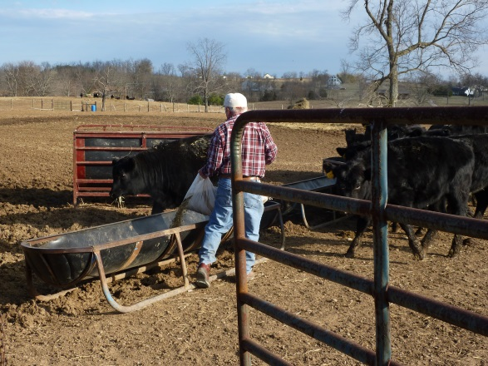
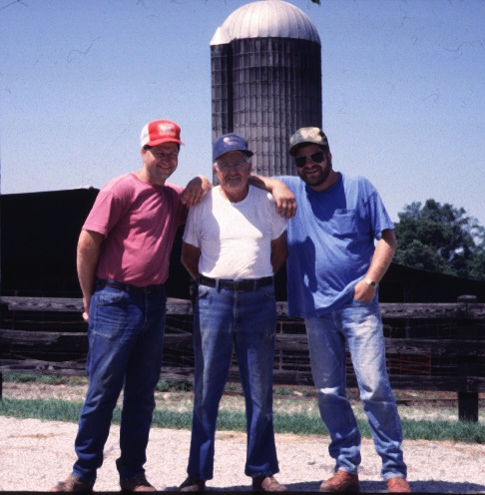
TOP HAZARDS
Machinery and equipment
Animals
Environmental
Internal

Slide 6
STRESS
Can’t live without it
“Stressed” is “dessert” spelled backward
(so it can’t all be bad!)

Slide 7
The three faces of stress
Distress
pain or suffering affecting the body, a bodily part, or the mind
a state of danger or desperate need
great pain, anxiety, or sorrow; acute physical or mental suffering; affliction; trouble.
Eustress
stress that is deemed healthful or giving one the feeling of fulfillment
De-stress
to relax your body or mind
to stop feeling the effects of stress
Notes:
We want to emphasize “de-stress”

Slide 8
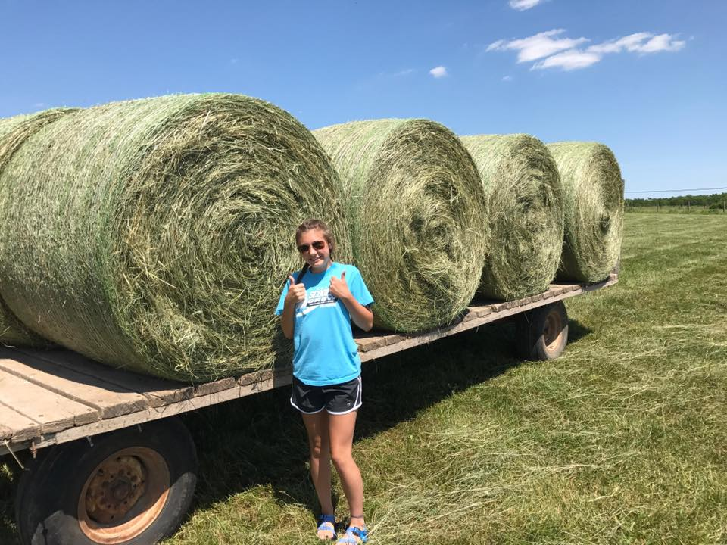
How can stress be good?
Stress is not always a bad thing
Stress is simply the body's response to changes that create taxing demands
EUSTRESS – Positive Stress | DISTRESS – Negative Stress
Motivates, focuses energy Is short-term Perceived as within our coping abilities Feels exciting Improves performance | Causes anxiety or concern Can be short- or long-term Perceived as outside of our coping abilities Feels unpleasant Decreases performance Can lead to mental and physical problems

Slide 9
Prolonged Stress
Stress causes the body to produce cortisol
Over time cortisol damages the interior of the blood vessels, creating the basis for hypertension.
It also deposits in the brain and may have a role in dementia and other neurological conditions
Bottom line: excessive cortisol secretion does more harm than good

Slide 10
STRESS
CVD
Impaired cognitive function
Diabetes
Chronic immunosuppression
Inflammatory response
↑ abdominal fat
↑ blood pressure
↑ blood sugar
immunosuppression
↑ C-reactive protein
Cortisol
(adrenal cortex)
TIME
TIME
↑ energy
↑ memory
↓ pain
↑ immunity
Relaxation
Return to normal levels
Notes:
Case example of global transient amnesia caused by stress- cost $15,000

Slide 11
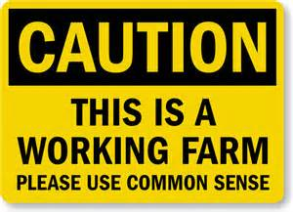
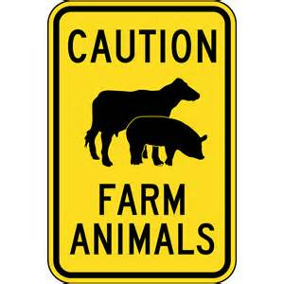
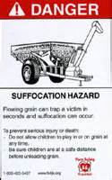
Notes:
So many warning signs, yet none of them warn us about our own reactions and responses to what is happening in the farm environment. What we really need is a sign to warn us. Instead, we have to be mindful of stress and keep it in check on a daily ( and sometimes hourly) basis.

Slide 12
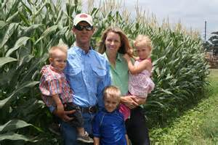
Current stressors
7 straight quarters of financial downturn
Weather this year
Wal-mart – the latest
Tariffs and Trade Wars
Family Expectations

Slide 13
Suicide Risk
Farmers and agricultural workers have higher rates of suicide deaths than any other occupation in the US.
84.5 per 100,000 among the farming, fishing, and forestry group (McIntosh, et al., 2016).
1990-1998 (3 Southeastern states)
Age 75-84 O.R. 2.0 (CI: 1.70-2.45)
Age > 85 O.R. 2.6 (CI: 2.02-3.54)
Notes:
This multitude of stressors places aging farmers at greater risk for depression and suicide as the literature illustrates. Eh article out of the CDC by McIntosh, Spies, Stone, Lokey, Trudeau, & Bartholow (2016) is what has sparked America’s interest in this topic. This is 4 times higher than the risk of suicide for military veterans.
A study conducted by Gunderson et al. looked at suicide rates among farmers in Wisconsin, Minnesota, North Dakota, South Dakota, and Montana from 1980 to 1988. They found that the suicide rate for these farmers was 48.1 per 100,000 individuals, which is more than twice as high as the overall suicide rate for adults in the United States. (Hovey & Seligman, 2006)
In a later study, Browning and colleagues (2008) examined suicides among farmers in three states (Kentucky, North Carolina, and South Carolina), during the period of 1990 to 1998. The results of the study confirmed an increased suicide mortality rate among white male farmers compared to the total white male population in these three states. They found that the increased rate of suicide was especially high among those aged 25-34 years, 75-84 years, and age 85 years and older. Male farmers in the 75-84 age group were twice as likely to die from suicide compared to the total white male population and male farmers 85 years or older were 2.6 times more likely to die from suicide.

Slide 14
What are the signs of stress?
Easier to recognize in others than in yourself!
Eating too much, or not at all
Weight loss or weight gain
More easily irritated or bothered
Sleepy more ( or less)

Slide 15
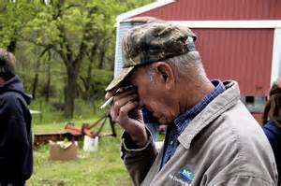
More signs of stress
Easily discouraged
Headaches
Hard to focus
Forgetful

Slide 16
Possible Consequences of Stress
Poor decision making
Anxiety
Depression
Suicidal thoughts

Slide 17
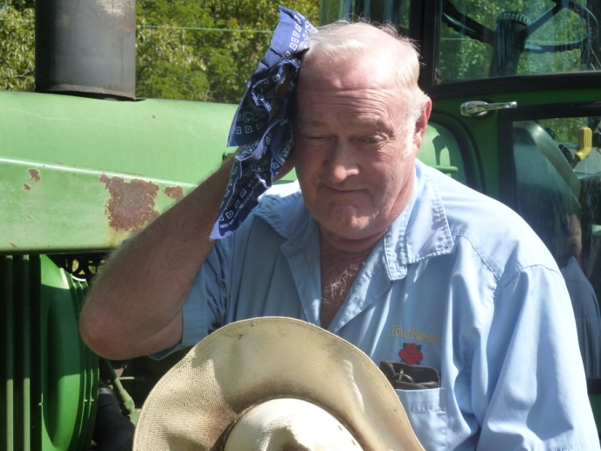
Signs of stress on the farm
Forgetting the task at hand
Misplacing tools ( more than usual)
Feeling overwhelmend

Slide 18
Signs of stress on the farm
Unreasonable anger
Destroying things in a fit of rage
Increased use of abusive or salty language
Panic attacks
Taking things out on family, workers, animals or things
Rushing

Slide 19
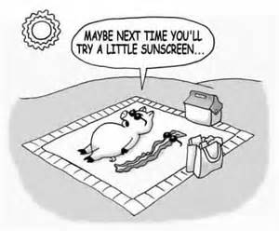
Lets talk about stress reduction
An ounce of prevention

Slide 20
Are you stressed yet? There’s a solution for that!
It’s normal – do something about what you can actually control
Organization- a top priority
Repair and replace
Pay those bills!
Keep a calendar
Sort papers once a week- respond, toss, file but don ‘t “re-pile”

Slide 21
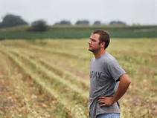
Work changes
Livestock: example: rethink calving season
Crops: switch to crops that require less labor, are more weather resilient
Schedule maintenance
Work around weather
Layer for temperature changes
Have a plan A, B, and C
Work in groups
Have a phone list of contacts for breakdowns and repairs

Slide 22
Stress busting
Goal: Address your stress every day
AM and PM: Stretch out stress

Slide 23
Stress Busters
B reathe | five slow deep breaths
R est | 7 hours sleep; short naps
E xercise | walking, cardio, mental, your faith
A ttitude | be positive
T alk it out | a friend; your dog; your faith
H elp someone else | Releases good hormones
E at right | fruits & veggies; low protein at night

Slide 24
Suggestions
Build stress reduction into your risk management plan
Make it a line item in your budget and your calendars
Vacation
Equipment that saves time or energy
Regularly scheduled “down time” and repair time
Preventive maintenance for yourself

Slide 25
Develop a mantra
Counting to ten
Press at the base of thumb

Slide 26
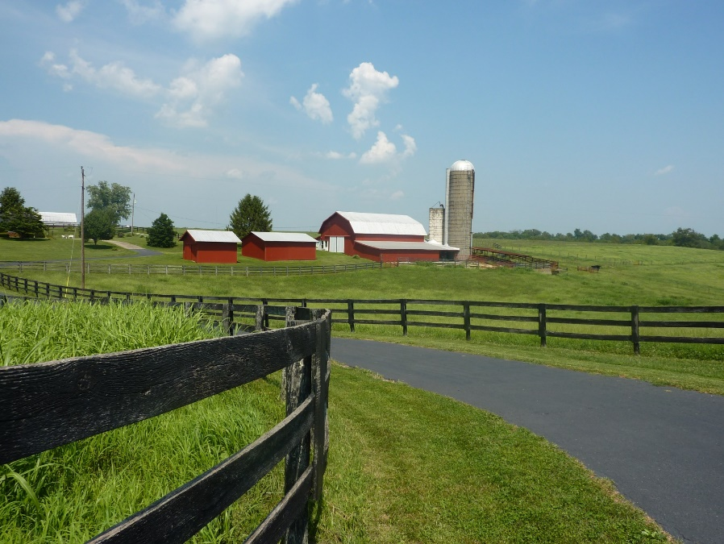
The best laid plans…
Plan your day and your week
Build in “down time” to address emerging issues
Write it down!
Have alternate plans (for when it rains)
Cross off your “to do” list
Just say NO

Slide 27
Stress Management
Sometimes stress overwhelms us
Talking it out
Professional assistance
What about pharmaceutical intervention?
It’s all on the table and acceptable!
Notes:
“forest bathing” the latest scientific advancement ( hahahaha we always know being out in nature is good for us!)

Slide 28
We all need a little help now and then
Notes:
“Pride goeth before a fall” or maybe before a dunking in mud! There is no sin in asking for help, just remember to pay back the favor when someone else needs a little help or a listening ear It all reduces stress!

Slide 29
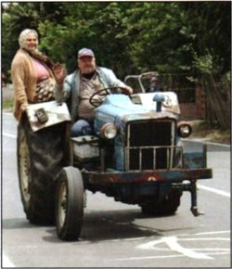
Sometimes (well, everyday) it’s a balancing act . . .
Source: Sealy Tractor Website – Mishaps and Funny Farm Photos, http://sealytractor.com/photos.php

Slide 30
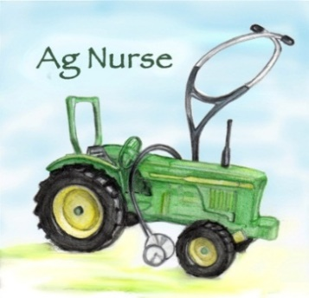
NURSE-AP
JOIN US ON FACEBOOK
http://www.facebook.com/Agriculture.nurse
OR dbreed01@uky.edu
Advancing agricultural health and safety nursing practice through emerging education and communication strategies, new clinical interventions, service learning, and community collaborations
Notes:
Addresses barriers to optimal care created by delayed access to agricultural health and safety research; lack of evidence-based nursing practice tailored to local farm communities; and the limited number of nurses with expertise in agricultural health and safety

