Slide 1
Farm Records
John Howe
Extension Agent, ANR
Spotsylvania County

Slide 2
What We Will Cover
Farm Records
What to keep
Why to keep
How to keep

Slide 3
Why Keep Farm Records
Historical information
Evaluate Business Performance
Planning
Communicate With Others – lenders, insurance
Insurance
Environmental Regulations
Estate Issues
Income Tax Issues

Slide 4
Historical Information – Real Estate
Purchase Contract
Settlement Statement received at closing
Deed
Plat and Survey (keep all)
Appraisals (keep all)
Photographs (all kinds)
Real Estate Tax Assessments (keep all)

Slide 5
Historical Information – Real Estate
Loan Information
Deeds of Trust
Settlement Records
Loan Agreements
Annual Loan History Statements
Cancelled Noted
Certificates of Satisfaction

Slide 6
Historical Information – Real Estate
Improvements (Buildings, Fences, Wells)
Construction contracts
Journal of expenses
Date Construction Started
Date Placed in Service
Depreciation Method Used

Slide 7
Historical Information – Personal Property
Equipment
Purchase Price – Contracts or Sales Agreements
Make and Model
Serial Number
Date of Purchase
Depreciation Schedule
Date sold or Disposed
Sale Price

Slide 8
Historical Information – Personal Property
Livestock
Purchase Price
Breed, Age, Sex (ID Numbers)
Identification Numbers & Registration Papers (if any)
Date of Purchase or Birth
Depreciation Schedule (breeding livestock)
Date Sold or Died
Sale Price
Contracts and Sales Agreements

Slide 9
Farm Record Systems
Adequate for all information needed to base business and production decisions on and file income taxes
Facilitate segregation into categories
Can be combined with check register
Pen, Calculator, and Paper
Computer Based
Should Retain Supporting Documents

Slide 10
Farm Record System – What to Look For
Easy to use
Provide information you need to monitor and evaluate your business
Based on commonly used documents – Checks, Deposit slips, Invoices, Etc.
Facilitate communication with others
Compliments or aids income tax preparation

Slide 11
Farm Record System – Income & Expenses
Categories – Income and Expense
Chart of Accounts
Use Schedule F Categories as a guideline
Cash receipts; crops, livestock, machine work, patronage dividend, etc.
Cash disbursements; feed, fertilizer, seed, interest, rent, utilities, etc.
Categories should support evaluating business performance
Subcategories may aid in evaluating specific aspects of your business

Slide 12
Farm Record System – Income & Expenses
Transaction Detail
What was purchased or sold
Amounts in pounds, bushels, bales or other units of measure
Parties
Date
Price
Retaining invoices and sales agreements will aid in capturing this information

Slide 13
Computer Based or Hand Kept Systems
Both are acceptable
Computer based systems automate repetitive tasks and support creating financial reports

Slide 14
Hand Kept Systems
All start with checks and deposits.
Recorded by hand in a check register.
Move to a ledger sheet.

Slide 15
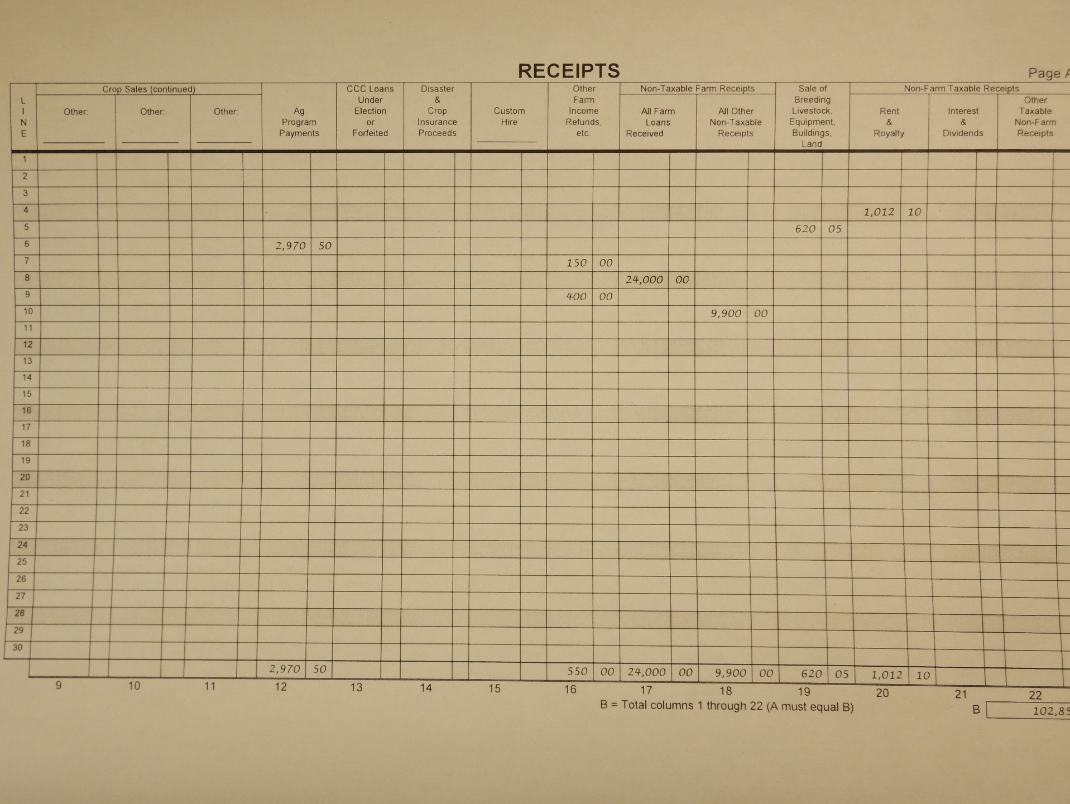
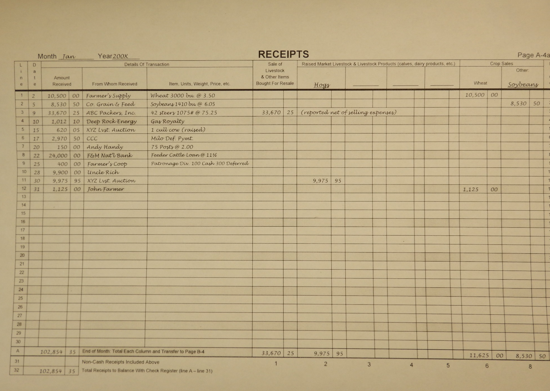
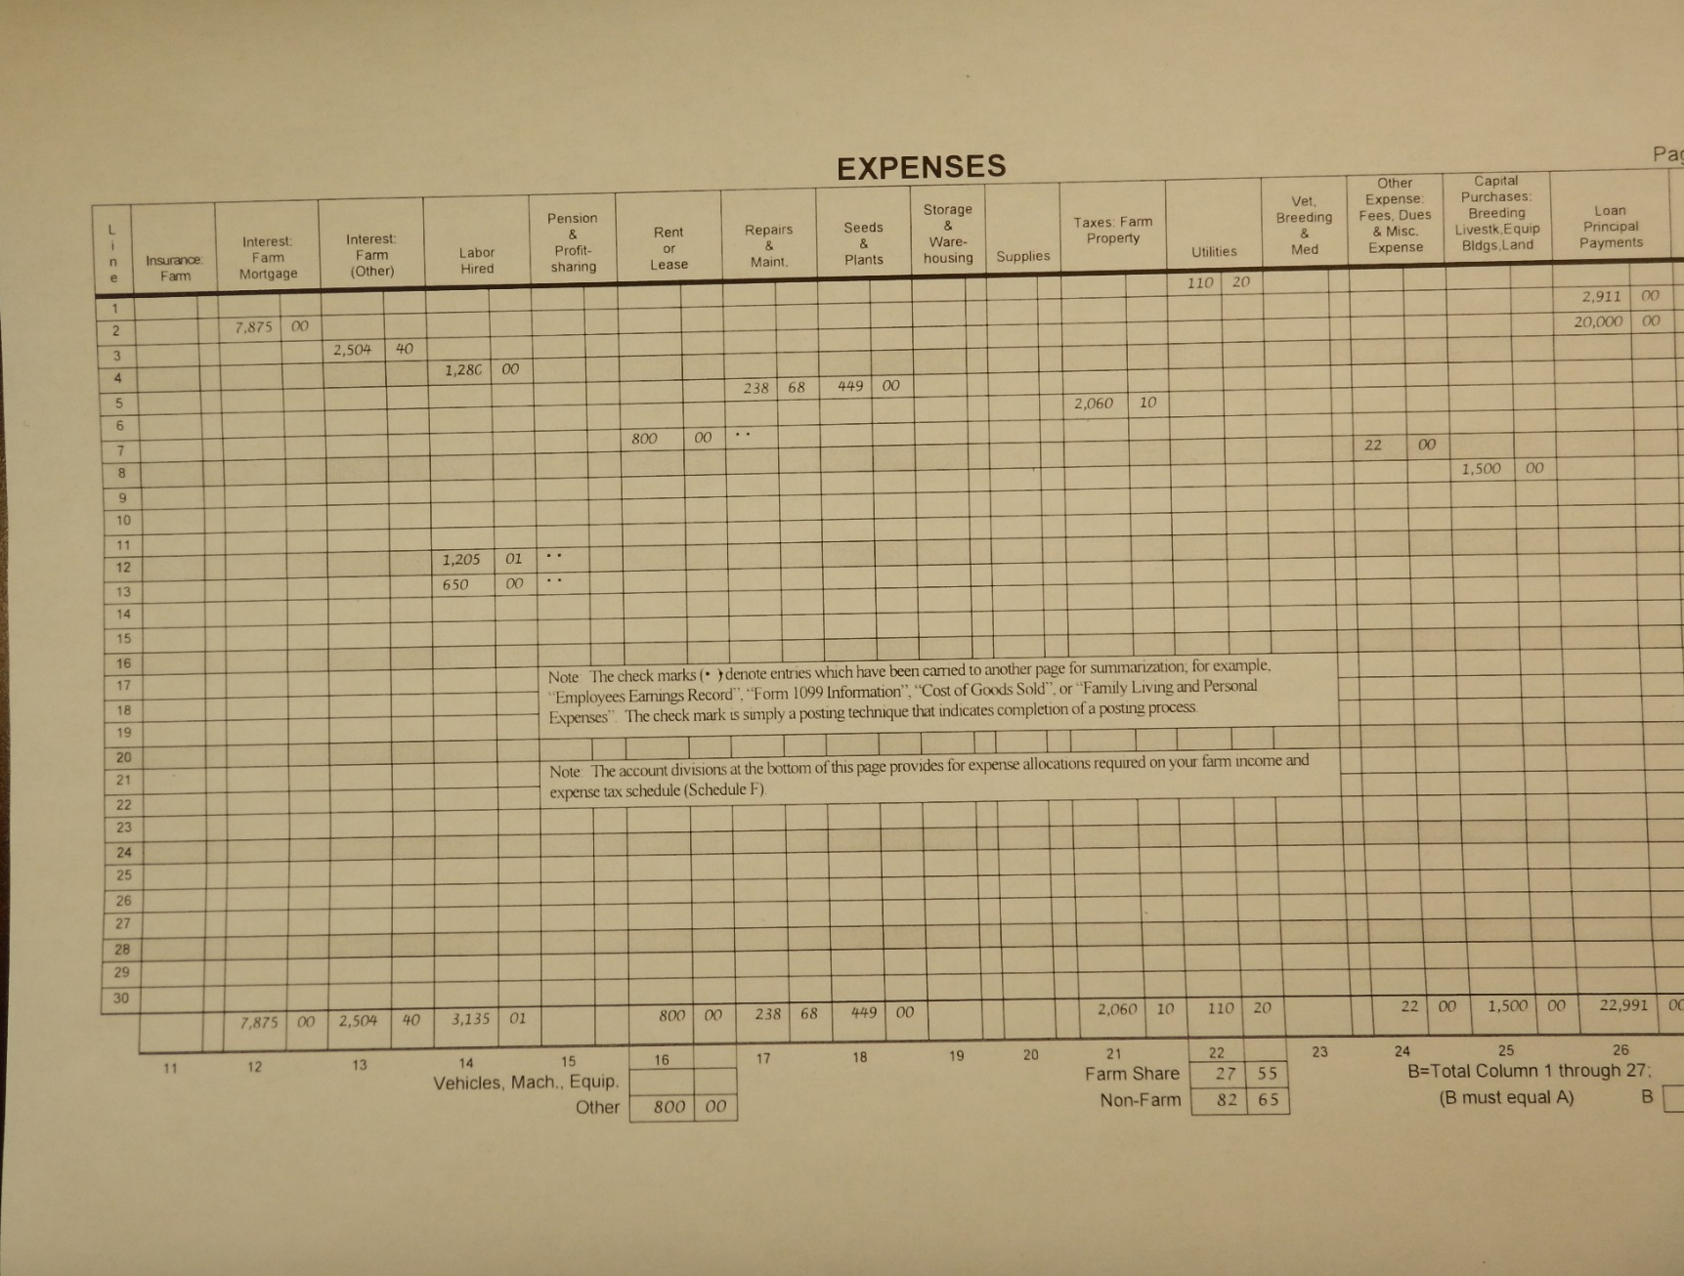

Slide 16
Computer Based Systems
Desirable Characteristics
Checkbook based
Flexible – Can be modified to suit your needs
Provide financial statements or reports
Income statement
Balance Sheet
Cash flow statement
Budget to actual reports

Slide 17
Quicken®
User friendly – learn as you go
Inexpensive and widely available
Flexible – Ag and Non-Ag enterprises
Looks like a check register
Category list can be changed to match Schedule F
Quick fill feature – completes repetitive transaction
Split transactions
Reports – balance sheet, cash flow and transactions

Slide 18
Quicken®
Loan Amortizations
Shortcomings
Inability to summarize physical data such as lbs., bu., -- harder to intergrade production and financial records.
Difficult to maintain depreciation schedules for individual assets.

Slide 19
QuickBooks®
User friendly – need to know accounting terms
Initial set up is more difficult
Invoices and payment tracking
Accounts payable
Inventory function is more for retail businesses than farming
Credit card payments

Slide 20
In Quicken® This replaces the check register

Slide 24
Individual Animal Treatment Record Farm Name_________________ Address ________________
 | Animal ID | Problem/diagnosis | Product | Dosage | Route of Admin | Site | Withdrawal |  | Notes | Initials
 |  |  |  |  |  |  | Time (Days) | Date
2/1/16 | 12 | Pneumonia | Antibiotic A | 5 cc | SQ | R neck | 5 days | 2/6/16 |  | jeh
2/2/16 | 12 | Pneumonia | Antibiotic A | 5 cc | SQ | L Neck | 5 days | 2/7/16 |  | fdp
2/3/16 | 12 | Pneumonia | Antibiotic A | 5 cc | SQ | R neck | 5 days | 2/8/16 |  | jeh
4/5/16 | 16 | Foot rot | Antibiotic B | 10 cc | SQ | R Neck 2 spots | 10 days | 2/15/16 |  | jeh

Slide 25
Group records can be used when treating a group of livestock with the same treatment at the same time.

Slide 26
Crop Production– by Field
Crop grown
Fertilizer and Lime applications – detail amounts per acre
Pesticides – detail amounts per acre
Seed variety
Planting date
Weed, insect and disease issues that occurred during the crop season
Harvest date
Yield
Cover crop

Slide 27
Disclaimer: Commercial products are named in this publication for informational purposes only. Virginia Cooperative Extension does not endorse these products and does not intend discrimination against other products which also may be suitable.

Slide 28
References and Resources
Ag Risk & Farm Management Library, http://www.agrisk.umn.edu/
Quicken® for Farm and Ranch Financial Records, Domona Doye, http://www.agrisk.umn.edu/Library/Display.aspx?RecID=4415
Quicken® for Farm and Ranch Financial Records, Quicken® Deluxe 2016, http://agecon.okstate.edu/faculty/publications/5162.pdf
Quicken® or QuickBooks®: What’s the Best Choice for Agricultural Producers? , Domona Doye, http://www.agrisk.umn.edu/Library/Display.aspx?RecID=4510

Slide 29
Virginia Cooperative Extension programs and employment are open to all, regardless of age, color, disability, gender, gender identity, gender expression, national origin, political affiliation, race, religion, sexual orientation, genetic information, veteran status, or any other basis protected by law. An equal opportunity/affirmative action employer. Issued in furtherance of Cooperative Extension work, Virginia Polytechnic Institute and State University, Virginia State University, and the U.S. Department of Agriculture cooperating. Edwin J. Jones, Director, Virginia Cooperative Extension, Virginia Tech, Blacksburg; M. Ray McKinnie, Interim Administrator, 1890 Extension Program, Virginia State University, Petersburg.

