Slide 1
Introduction to Whole Farm Business Plan Challenge

Slide 2
Introductions
Overview of Whole Farm Business Plan Challenge
What’s in a Whole Farm Business Plan

Slide 3
Introductions

Slide 4
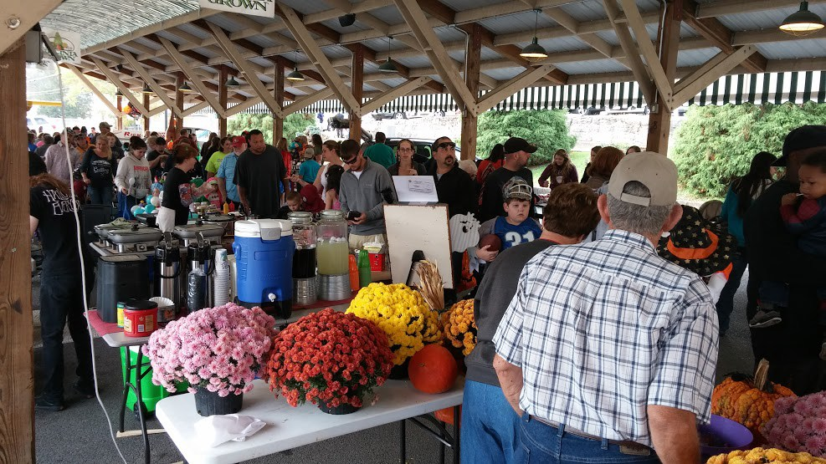
Introductions
Expecting 27 attendees
18 Females and 9 Males
Representing more than 550 acres of land

Slide 5
Introductions
The long-term goal of the Virginia Beginning Farmer & Rancher Coalition Program (VBFRCP) is to improve opportunities for beginning farmers and ranchers to establish and sustain viable agricultural operations and communities in Virginia.
Appalachian Sustainable Development’s mission is to transition Appalachia to a more resilient economy and a healthier population by supporting local agriculture, exploring new economic opportunities and connecting people to healthy food.

Slide 6
Overview of Whole Farm Business Plan Challenge

Slide 7
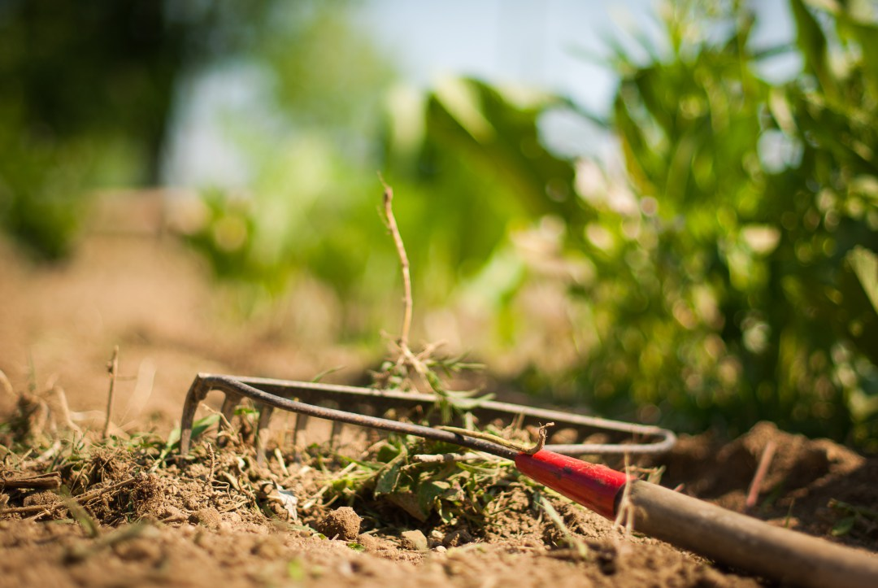
Purpose of Webinar Series
Provide in-depth business planning training and one-on-one support
Provide support and inspiration for farmers to:
Put their farm business plans on paper
Implement record keeping strategies
Have and use record keeping tools to evaluate farm business performance
Make wise business decisions
Connect to markets that are appropriate for their size, scale, skills and interests

Slide 8
Webinar Outline
Five more webinars:
October 6
Financial Needs Assessement - Amy Fannon, VA Tech Extension
October 13
Basic Book keeping – Audrey Powers, BB&T
October 20
Forms of Incorporation – Andrew Branan, The Branan Law Firm PLLC
November 3
Managing Legal Liability – Scott Denoon, Virginia Farm Bureau
November 10
Record Keeping and Taxes - John Howe, VA Tech Extension

Slide 9
Guidelines for Challenge
To win one of the competitive awards, the farm must be located in southwest Virginia or northeast Tennessee within ASD’s service area
The following will be awarded from ASD, Virginia Beginning Farmer & Rancher, and Wells Fargo to the winners:
1st Place - $400
2nd Place - $200
3rd Place - $100
Eligible Business Categories
Crop production
Livestock and other animal operations
Agritourism
Value added products from the farm
Other farm related businesses – check with us when you register
Full guidelines available at asdevelop.org/sustainable-agriculture

Slide 10
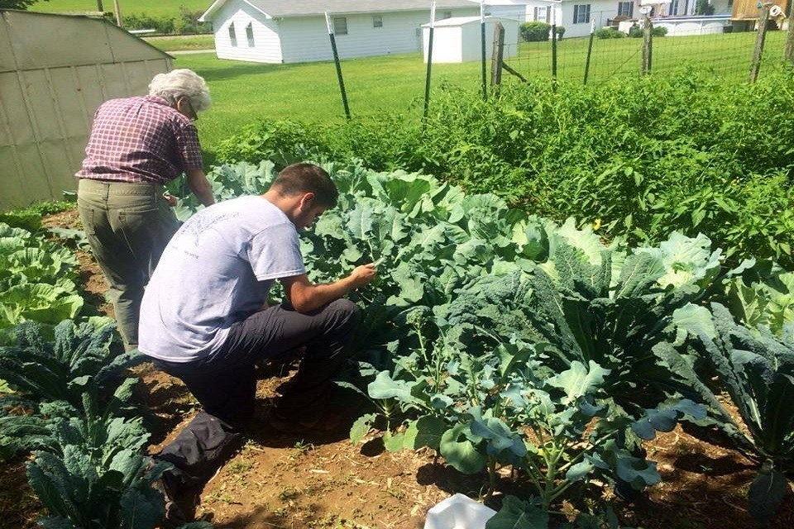
Submitting Your Business Plan
Email to tmcnaughton@asdevelop.org by 5pm on November 10th
Awardees will be notified by December 1st

Slide 11
Scoring
Whole Farm business plans will be scored using several criteria
Strength of business plan
Adherence to rubric provided
Attendance at all webinars
Attendance taken through your completion of
program evaluations at the end of each webinar
Full Scoring Chart used to select awardees is available at asdevelop.org/sustainable-agriculture
Judges are selected from out of region to review and score submitted plans

Slide 12
Overview
Program weighted heavily on writing things down (record keeping)
Record Keeping is the life breath of your business plan

Slide 13
What’s in a Whole Farm Business Plan

Slide 14
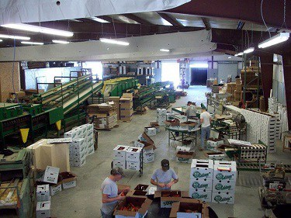
Whole Farm Planning
A holistic four step process used by farmers to help balance the
quality of life they desire with
the farm’s resources,
the need for production and profitability,
and long term stewardship.
Designed to be flexible and evolve with farm/farmer.
It’s a constant PROCESS rather than a final PRODUCT

Slide 15
4 Steps of Whole Farm Planning
Setting Goals
Making an Inventory of Farm Resources and Preferences
Developing and Implementing an Action Plan
Monitoring On-Farm Progress Toward Goals (Revisit Plan and Goals)
https://pubs.ext.vt.edu/AEE/AEE-50/AEE-50-PDF.pdf

Slide 16
Basic Business Plan Outline
Don’t forget Cover Page, Table of Contents, and any appendices

Slide 17
Financials
Cash flow projections for three years
Loan amortization schedule if requesting a loan
Detailed assumptions for each line item
Income Statement (Profit & Loss)
Balance Sheet
Risk factors: identify major risks and describe how business will overcome them

Slide 18
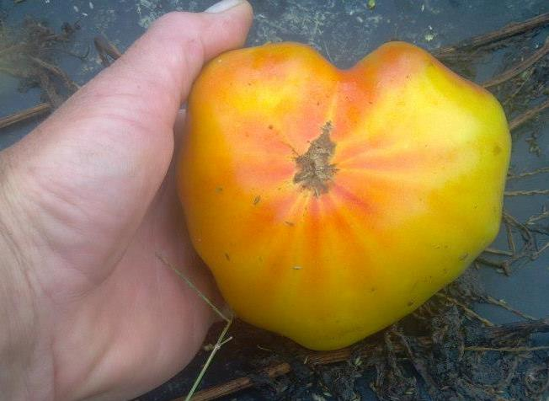
Product and/or Service Description
What makes it unique or desirable
Drawings, photos, sales brochures, and other bulky items belong in Appendices
What factors will give you competitive advantages or disadvantages?
What are the pricing, fee, or leasing structures of your products or services?

Slide 19
Marketing
Target market/customer profile
Industry analysis
Market analysis

Slide 20
Marketing
Describe the five “Ps” for your business
Product
Price
Place
Promotion
People
Competition: list of competitors by name, location, and their strengths and weaknesses; how you will succeed; how they will react to your entry in the market

Slide 21
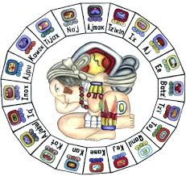
The action plan/schedule of implementing chosen strategies

Slide 22
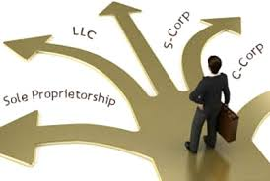
Operations
Legal structure
Management and
personnel
Customer service

Slide 23
Operations/Production
Location
Your facility, including store (booth) layout
Description of business image, hours of operation
How you will deliver your products/service to the customer, from start to finish (who does what tasks, how long it takes, etc.)
Taxes to be paid, licenses required, and insurance needed
Key people: who will provide accounting and legal services, technical assistance and support
Dissolution Plan – Land Transfer Strategy

Slide 24
Executive Summary
One page summary of the plan
Brief description of the business
Product and/or service description
Marketing description
Operations (production) description
Financials overview
If you are seeking a loan, include the amount requested, over what period you wish to repay it, the use for the loan proceeds, collateral you are prepared to offer, and your equity investment.

Slide 26
Questions?
Tamara McNaughton
Agriculture Program Manager
(276) 623-1121
tmcnaughton@asdevelop.org

